Slide 1
Lab 1: Arithmetic in Python SUNY Korea - Francois Rameau Spring 2023

Slide 2



Preliminaries
Write your first executable program !
1. Create a python file
2. Write your code
3. Run your code
Use your favorite editor (VSCode, Notepad++, etc.) and create a python file “Hello.py”.
And save it at the location you like.
In the first line, type the following:
Save and exit
Execute by typing this command in the terminal:
Quizzes
Quizzes
Quizzes
print(“Hello world.”)
python hello.py

Slide 3
Preliminaries
You can also replace this line with a more complex code!
num = 10 # You can change this later
other_num = num * 4
print(other_num)
print(num)
print(str(num))
# Not a very useful code, though
What are the ‘#’ symbols?
Comments!
Use as often as you can: in-code documentation is a very good habit
What does the ‘str(…)’ code do?
That’s a conversion-to-string code
It’s used to convert the given data into a string
What happens if we don’t use str(…) ?

Slide 4
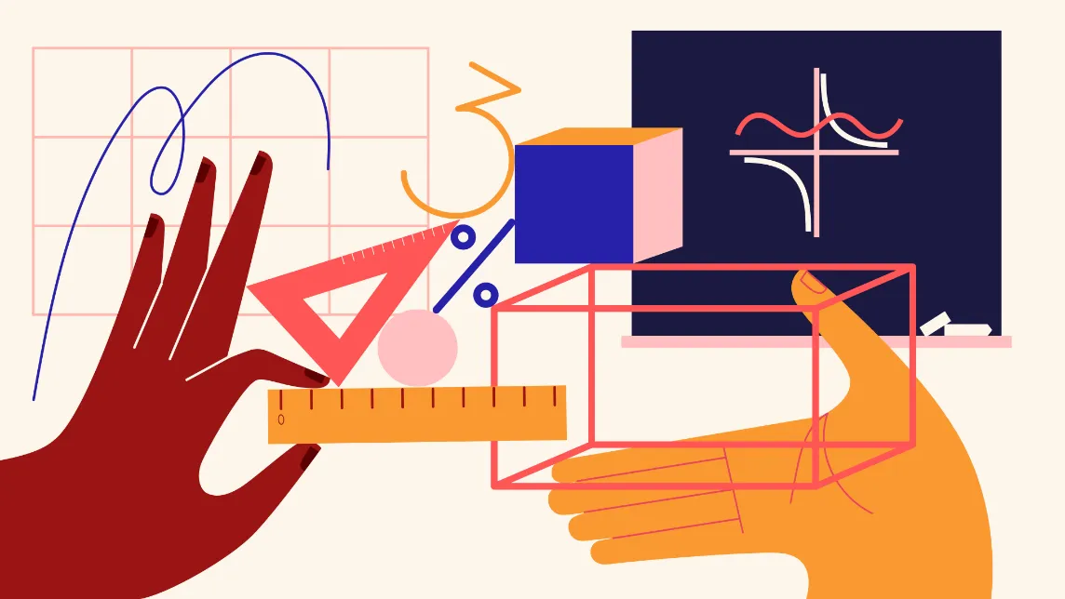

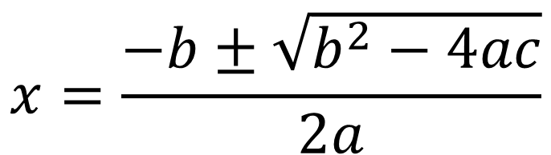
Quadratic equation
Do you remember the solution to a quadratic equation?
The solution of x is expressed as a combination of values: a, b, c
That means we can write a program that can automatically calculate this, given those three values!
$$ax^{2}+bx+c=0$$
$$x=\frac{−b±\sqrt{b^{2}−4ac}}{2a}$$

Slide 5
Task 1
Complete the first part of quad.py
Need to fill in the ellipsis (…) to implement the quadratic formula
Remember there are two roots!
Conditions
You must only use arithmetic operators
Do not use anything we haven’t learned in class yet. That qualifies as a 0.
Do not change anything besides the two lines you’re supposed to add

Slide 6
Task 2
Let’s do division (for kids)
When you divide two numbers, you get a quotient and a remainder
3 / 2 is 1 with remainder 1
10 / 3 is 3 with remainder 1
1 / 4 is …?
In this task, you are to declare two variables x and y
Initialize them to whatever positive values you like
You should compute a quotient and a remainder
E.g., for x = 10 and y = 3, the output should look like this:
Same conditions as task 1
Fill in quad.py’s second part
Submit quad.py to Github Classroom when you’re done (due the end of tonight)
You may leave if you’re done
3
1

